Slide 1
NET. 012
Database Access
Notes:
©2019 John Hinz

Slide 2
Agenda
ADO.NET (continued)
Commands
ExecuteNonQuery
ExecuteReader
ExecuteScalar
ExecuteXmlReader
Notes:
Section Start Slide

Slide 3
Commands
A command is, in its simplest form, a string of text containing SQL statements to be issued to the database.
ExecuteNonQuery— Executes the command and returns the number of rows effected
ExecuteReader— Executes the command and returns a typed IDataReader
ExecuteScalar— Executes the command and returns the value from the first column of the first row of any result set
ExecuteXmlReader— Executes the command and returns an XmlReaderobject, which can be used to traverse the XML fragment returned from the database

Slide 4
Command Text
The SqlCommand type has a CommandText property
The CommandText property allows a developer to associate the SQL to be executed when the connection is opened and the appropriate ‘Execute’ action is called.

Slide 5
Parameters Property
The SqlCommand has an attribute called Parameters which is a SqlParametersCollection type.
The Parameters allows you to specify the values required in the CommandText property.

Slide 6
ExecuteNonQuery
The ExecuteNonQuery method is commonly used for UPDATE, INSERT, or DELETE statements, for which the only returned value is the number of records affected
ExecuteNonQuery returns the number of rows affected by the command as an int.

Slide 7
ExecuteReader
The ExecuteReader method executes the command and returns a typed data reader object
The data reader object returned can be used to iterate through the record(s) returned by the CommandText

Slide 8
ExecuteReader (cont)
The reader has several methods for getting data returned from CommandText
These methods return a specific datatype and take an integer. The integer is the zero based column number.
E.g.
GetGuid(0) will return a Guid from column zero

Slide 9
ExecuteScalar
Sometimes it is necessary to return a single result from a SQL statement, such as the count of records in a given table or the current date/time on the server
This method returns an object, which you can cast to the appropriate type if required.

Slide 10
ExecuteXmlReader
SQL Server provider only
Executes a SQL statement and returns an XmlReader object to the caller.
SQL Server permits a SQL SELECT statement to be extended with a FOR XML clause.
FOR XML AUTO— Builds a tree based on the tables in the FROM clause
FOR XML RAW— Maps result set rows to elements with columns mapped to attributes
FOR XML EXPLICIT— Requires that you specify the shape of the XML tree to be returned

Slide 11
Understanding Errors with ADO.NET
Catching database errors and inspecting error messages
SqlException and SqlError classes

Slide 12
Bind a DataTable to a control
Display the disconnected dataset in your application
Use the SqlDataAdapter
SqlDataAdapter adapter = new SqlDataAdapter( "select * from Courses", conn);
adapter.TableMappings.Add("Table", "Courses");
adapter.Fill(ds);
txtCourse.DataBindings.Add(new Binding("Text", ds, "Courses.Name"));

Slide 13
SqlConnection.StatisticsEnabled
Enabling client side statistics gathering
SQL Server/SQL Database performance issues
Are you waiting a lot on server resources?
Network latency?
Inspecting the behavior of your client application
Are you consuming too many rows? Too many roundtrips?

Slide 14
Enabling Statistics
Open Connection to SQL Server or SQL Database
A connection must be established before enabling statistics
Execute Statement against the database
Captures time spent on the server, plus the time spent by the provider
Call RetrieveStatistics
Returns a collection of KeyValuePair containing the statistics

Slide 15
Managing Concurrency and Transactions
Autocommit vs. Implicit vs. Explicit Transactions
Autocommit = Default
By default, the database automatically commits statements
Implicit requires COMMIT or ROLLBACK
In implicit mode, a transaction starts automatically
Use BeginTransaction to declare an Explicit transaction
In explicit mode, a transaction requires a COMMIT

Slide 16
Managing Concurrency and Transactions (cont)
Database
BEGIN TRAN and COMMIT TRAN in SQL Server/SQL Database
Server-side transactions offer highest performance
Local
Within .NET using TransactionScope or BeginTransaction
Distributed Transactions
Involves the Distributed Transactions Coordinator (DTC)
Applies when multiple databases/systems are involved
Use TransactionScope to promote to full distributed transactions

Slide 17
Managing Optimistic Concurrency
Concurrency Models
No concurrency checks: Last update wins
Pessimistic Concurrency: Lock established while records are being changed
Optimistic Concurrency: Lock established during the commit phase

Slide 18
Connection Pooling
Reasons for connection pooling
Improves application performance
Improves database scalability
What controls connection pooling
Connection String
Currently logged on user for connections with Integration Security
Transaction state
Multiple connections are needed when
Applications use multi-threading to connect to a database
Different connection strings are used over time

Slide 19
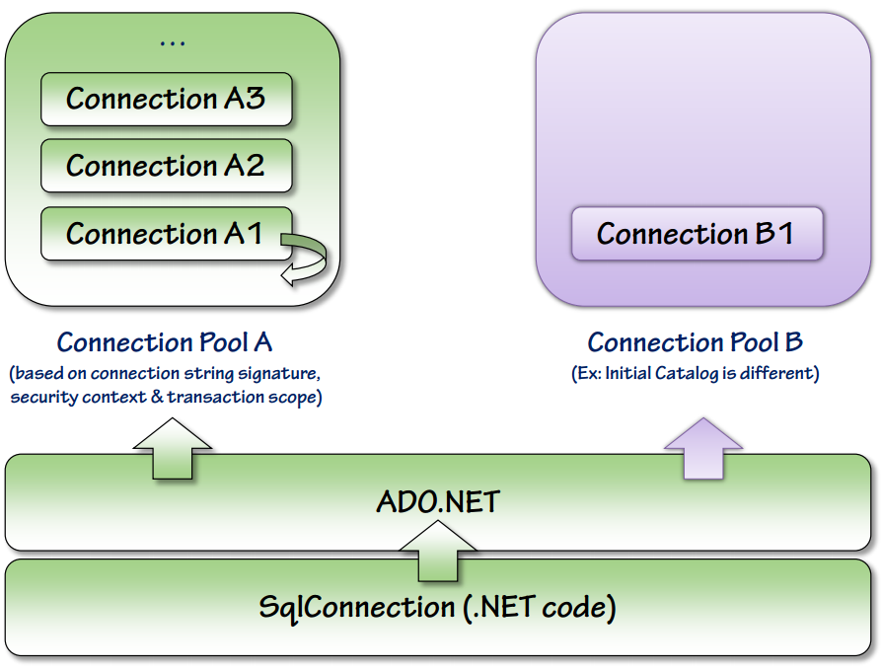
Connection Pooling (cont)

Slide 20
THANK YOU.
Notes:
Sign Off Slide

